Slide 1

CMR COLLEGE OF ENGINEERING & TECHNOLOGY
AN AUTONOMUS INSTITUTION WITH NAAC ACCREDITAION (A⁺ GRADE)
APPROVED BY AICTE, PERMANENTLY AFFILIATED TO JNTUH, NBA ACCREDITATION
KANDLAKOYA (V), MEDCHAL ROAD, HYDERABAD -501401.
COURSE NAME : COMPUTER ORIENTED STATISTICAL METHODS
COURSE CODE : A400006
ROLL NUMBER : 22H51A0588
NAME OF THE STUDENT :G.SOWMYA
BRANCH & SECTION : CSE D
SEMESTER : IV
ACADEMIC YEAR : 2023 - 2024
NAME OF THE TOPIC : BINOMIAL DISTRIBUTION

Slide 2
BINOMIAL DISTRIBUTION
22H51A0588 – G.SOWMYA

Slide 3
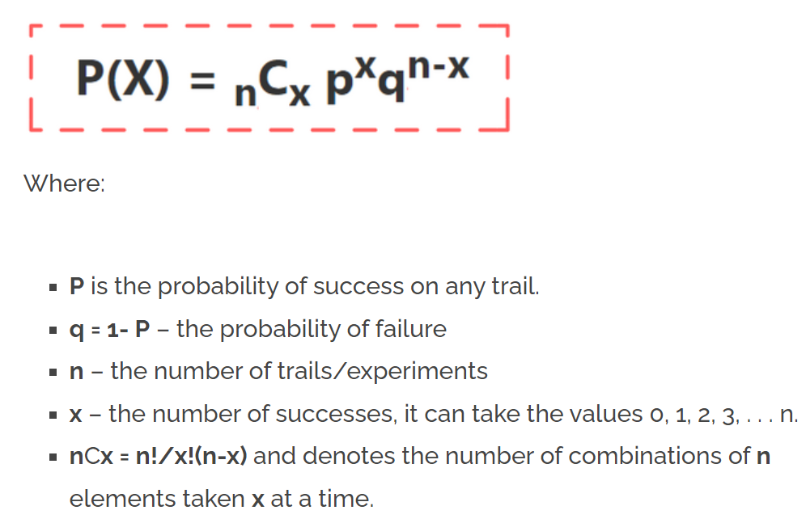
BINOMIAL DISTRIBUTION
It is the discrete probability distribution that gives only two possible results in an experiment, either Success or Failure.
A Random Variable ‘X’ having the probability distribution f(x) = p(X=X) =B(x,n,p)=P(x:n,p) = ^{n}C_{x} p^{x} (q)^{n-x}

Slide 4
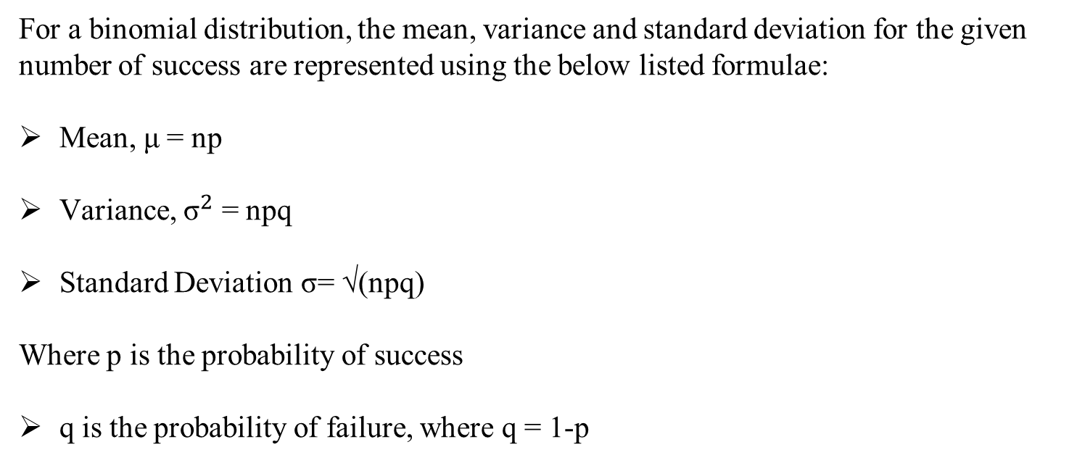
Important Formulae of Binomial Distribution
For a binomial distribution, the mean, variance and standard deviation for the given number of success are represented using the below listed formulae:
Mean, μ = np
Variance, ${\text{σ}}^{2}$ = npq
Standard Deviation σ= √(npq)
Where p is the probability of success
q is the probability of failure, where q = 1-p

Slide 5
PROBLEM 1 : If a coin is tossed 5 times, find the probability of:
(a) Exactly 2 heads
(b) At least 4 heads.
Solution:
a) According to the problem:
Number of trials: n=5
Probability of head: p= 1/2
the probability of tail, q =1/2
For exactly two heads:
x=2
P(x=2) = ⁵C2 p² q⁵⁻² = 5! / 2! 3! × (½)²× (½)³
P(x=2) = 5/16

Slide 6
(b) For at least four heads,
x ≥ 4,
P(x ≥ 4) = P(x = 4) + P(x=5)
Hence,
P(x = 4) = ⁵C4 p⁴ q⁵⁻⁴ = 5!/4! 1! × (½)⁴× (½)¹ = 5/32
P(x = 5) = ⁵C5 p⁵ q⁵⁻⁵ = (½)⁵ = 1/32
Therefore,
P(x ≥ 4) = 5/32 + 1/32 = 6/32 = 3/16

Slide 7
PROBLEM 2 :Let’s say that 80% of all business startups in the IT industry report that they generate a profit in their first year. If a sample of 10 new IT business startups is selected, find the probability that exactly seven will generate a profit in their first year.
Solution:
First, do we satisfy the conditions of the binomial distribution model?
There are only two possible mutually exclusive outcomes – to generate a profit in the first year or not (yes or no).
There are a fixed number of trails (startups) – 10.
The probability of success for each startup is p=0.8.

Slide 8
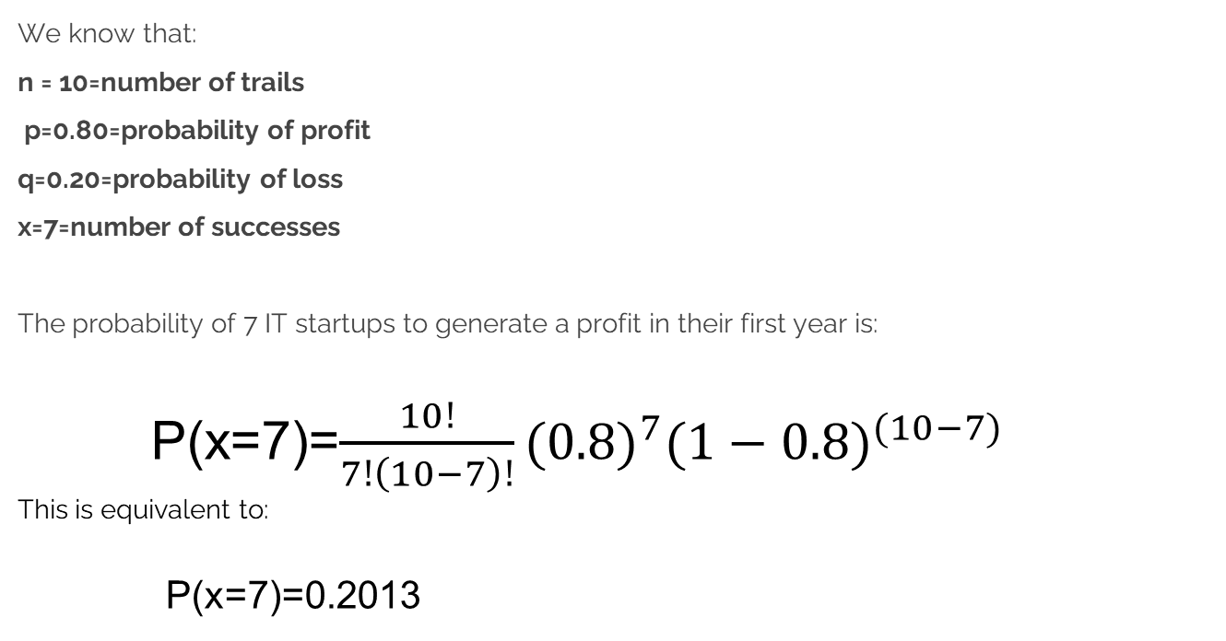
We know that:
n = 10=number of trails
p=0.80=probability of profit
q=0.20=probability of loss
x=7=number of successes
The probability of 7 IT startups to generate a profit in their first year is:
P(x=7)=$\frac{10!}{7!\left(10−7\right)!}{(0.8)}^{7}{(1−0.8)}^{(10−7)}$ This is equivalent to:
P(x=7)=0.2013

Slide 9

APPLICATIONS OF BINOMIAL DISTRIBUTION
Quality Control in Manufacturing: In manufacturing processes, companies often use the binomial distribution to assess quality control. For example, a company producing light bulbs may use it to determine the probability of a certain number of defective bulbs in a batch produced under the same conditions.

Slide 10

APPLICATIONS
Medical Trials: In clinical trials for new drugs or treatments, researchers often use the binomial distribution to analyze the outcomes. They may be interested in the number of patients who respond positively to the treatment versus those who don't, which can be modeled using the binomial distribution.

Slide 11

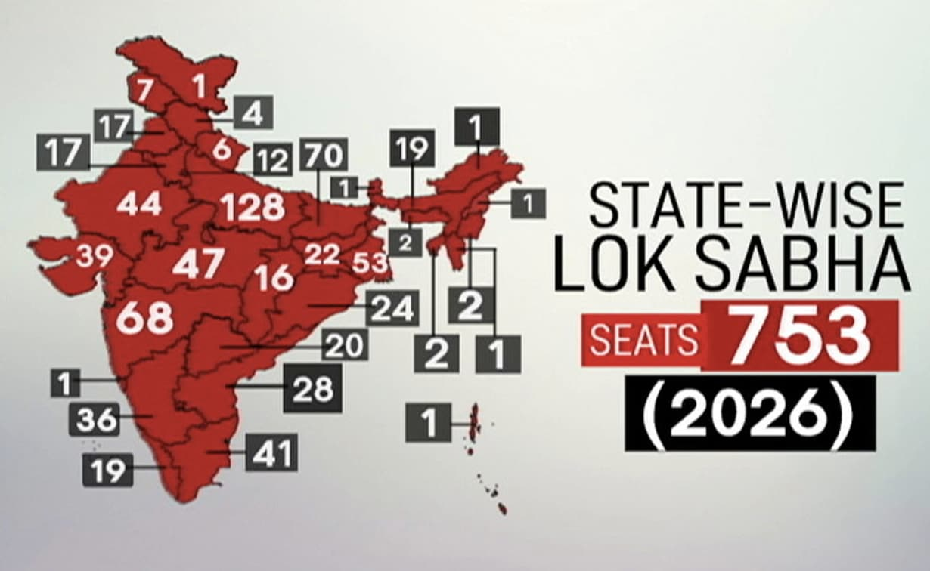
APPLICATIONS
Election Outcomes: During elections, pollsters and analysts use the binomial distribution to predict the probability of a certain candidate winning based on polling data. They consider factors such as the number of voters, polling margins, and historical voting patterns.

Slide 12
THANK YOU

